Slide 1

NYNEX FINSERV
Your key to Financial Freedom

Slide 2
Our Mission
To partner with Clients
For long-term relationships
By offering trusted financial investment recommendations
Strive to provide financial freedom by delivering tailored objective advice
Designed to give clients the confidence to pursue their own passion, dreams and talents

Slide 3
Our Vision
Our vision is to help clients feel confident about their future and pursue their financial goals. Through our comprehensive approach, we develop customized financial and retirement strategies that address your short and long-term needs. We are independent advisors, meaning that our recommendations are always in the best interests of our clients and their needs are at the core of everything we do.
Together, we hope to grow multi-generationally and go above and beyond for your needs.

Slide 4
Core Values
At Nynex Finserv, we recognize the significant duty we owe to our clients. We take pride in providing our clients with financial security and peace of mind during times of mounting concern and uncertainty. It is our pleasure to assist our clients in meeting their day-to-day financial challenges as well as their long-term goals. Our Core Values reflect how we want to care for our clients. The founding principles are –
Integrity: Provide professional services with integrity.
Objectivity: Provide professional services objectively.
Competence: Maintain the knowledge and skill necessary to provide professional services competently.
Fairness: Be fair and reasonable in all professional relationships. Disclose conflicts of interest.
Confidentiality: Protect the confidentiality of all client information.
Professionalism: Act in a manner that demonstrates exemplary professional conduct.
Communication: Consistent communication and engagement between us and our clients creates an informed relationship.

Slide 5
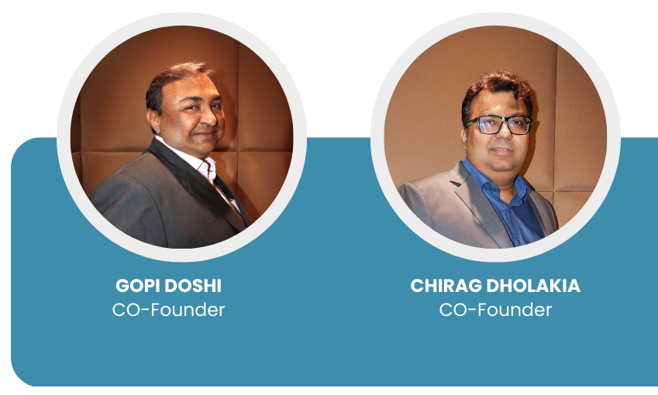
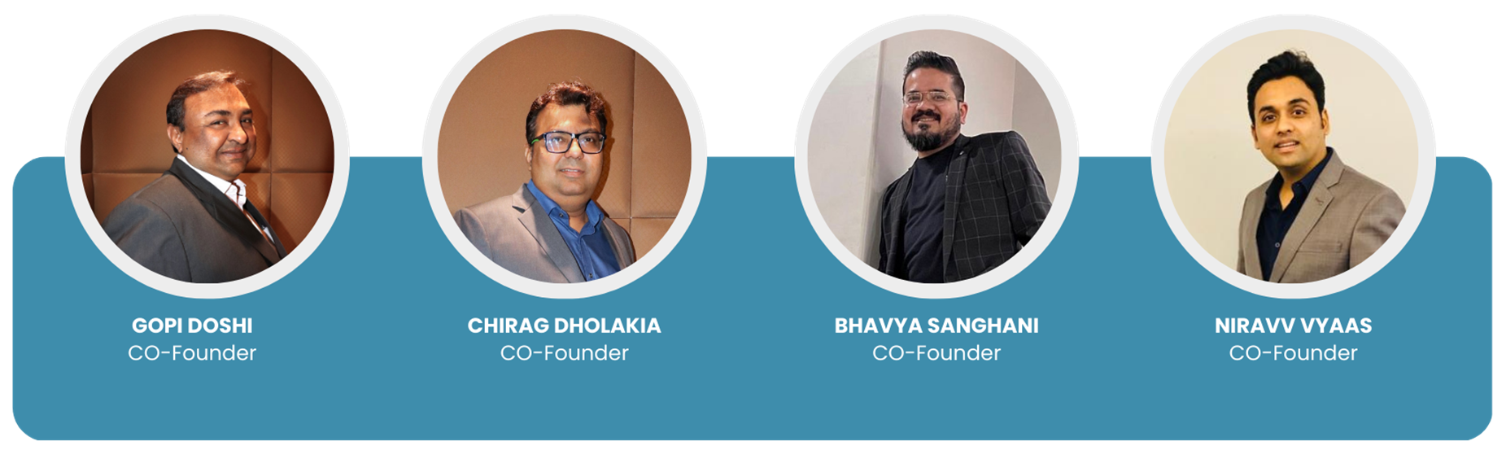
Co-Founders

Slide 6
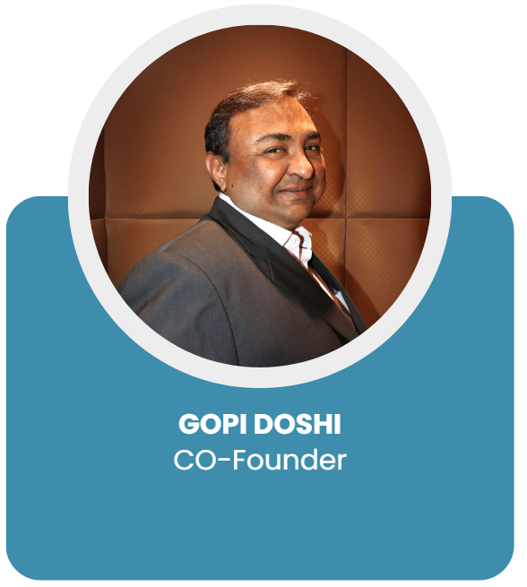
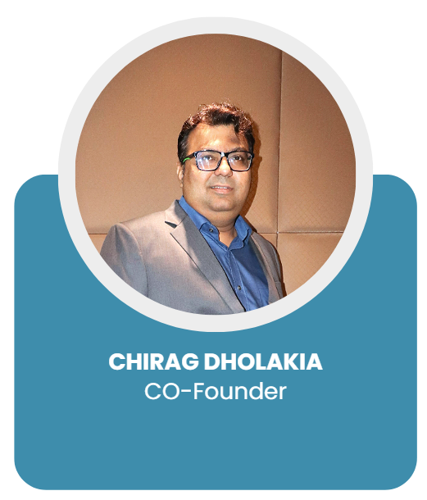
Gopi Doshi
Total experience of 29 years in the Financial Markets.
Worked with Alchemy Capital, ICICI Bank – Wealth, Motilal Oswal, Sharekhan, LKP Shares & Securities to name a few.
Education – B. Com and MBA
Chirag Dholakia
Total experience of 20 years in the Financial Markets.
Worked with Karvy Family Office, ICICI Securities, Anand Rathi, Religare Macquarie Private Wealth & Standard Chartered Bank.
Education – B. Com, M.Com and MBA Finance

Slide 7
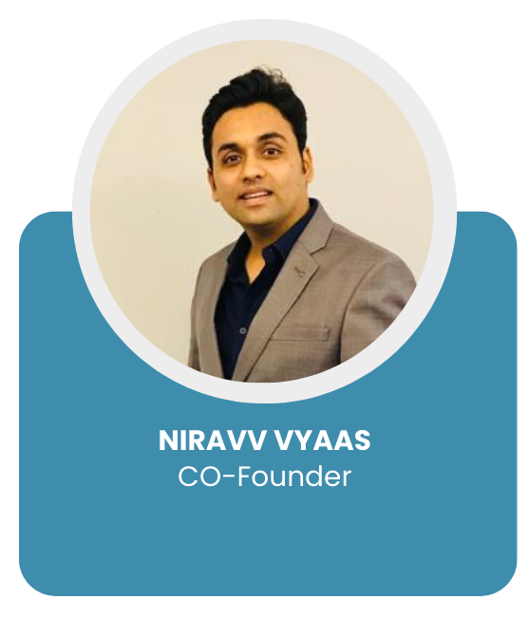
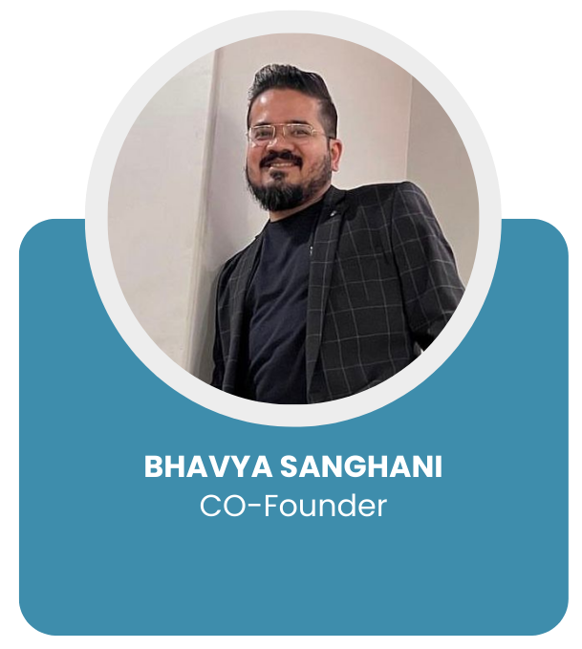
Niravv Vyaas
Total experience of 18 years in the Financial Markets
Worked with Indiabulls Group
Education – B. Com and MBA Finance
Bhavya Sanghani
Total experience of 17 years
Worked with Malik Makaan, Sahakar Global Ltd. & Tech Mahindra
Education – Masters in Mechanical Engineering (Automobile)

Slide 8
Products Offered – Financial
Portfolio Management Services (PMS)
  All the leading PMS Houses in the Country
Off Shore Funds
  All the leading PMS Houses offering Off-Shore Funds for foreign nationals who want to invest and participate in the Indian Growth Story through Gift City.
Alternate Investment Funds (AIFs)
  Investment offerings in Category I / II / III Funds.

Slide 9
Products Offered – Financial
Mutual Funds (MFs)
  Tie-up with all major Mutual Funds in India for Equity, Debt, PMS and AIFs through Gift City.
Fixed Income Products
  Bonds
  Fixed Deposits
Equity Broking
  Tied-up with Motilal Oswal Financial Services Ltd. as a Business Associate

Slide 10
Products Offered – Real Estate
Onshore Real Estate
  Participate and market new project launches of reputed Developer like Godrej, Adani, Lodha, Chandak, Transcon, Oberoi, Rustomjee, Sheth, Suraj, Birla, Raheja, Sethia, etc.
Offshore Real Estate
  Marketing Dubai properties for Developers like Emaar, Damac, Shobha, Danube, SLS Property, Azizi, Dugasta, etc.
Home Loans
  Tie-up with all major Banks and Financial Institutions for providing Home Loans and Loan against Property requirements of our customers
Other Mortgages
  Tie-up with all major Banks and Financial Institutions for Business / Working Capital Loan requirements of our clients.
  Project Finance

Slide 11
INVESTMENT PRODUCT
OFFERINGS

Slide 12
Investment Recommendations
 | AIF ValueQuest – VQ FasterCap Fund – Open Ended Category III AIF (New Fund Offer) Alchemy Leaders of Tomorrow – Open Ended Cat III AIF Buoyant Opportunities Fund – Open Ended Category III AIF | PMS ValueQuest Platinum Fund (Minimum ticket size – Rs. 5 crores) Alchemy High Growth – Select Stock Fund (Minimum ticket size – Rs. 3 crores) Unifi Capital – The Blended Rangoli Fund Negen Capital Special Situation & Technology Fund Buoyant Opportunites Fund ValueQuest Growth Fund
Mutual Funds Aditya Birla Sunlife Multicap Fund – Multicap Fund Tata Flexi Cap Fund – Flexi Cap Fund HDFC Top100 Fund – Large Cap Fund Franklin India Prima Fund – Midcap Fund Kotak Emerging Equity Fund – Midcap Fund Quant Small Cap Fund – Small Cap Fund SBI Focussed Equity Fund – Focussed Fund Motilal Oswal Large and Midcap Fund – Large & Midcap Fund |  | ELSS Canara Robeco ELSS Tax Saver Fund HDFC ELSS Tax Saver Fund Children’s Fund SBI Magnum Children’s Benefit Fund – Investment Plan Balance Advantage Fund (BAF) HDFC Balance Advantage Fund Nippon India Balance Advantage Fund

Slide 13
Investment Recommendations – AIF (New Fund Offer)
ValueQuest – VQ FasterCap Fund – AIF – Cat 3 – Open Ended
ValueQuest – VQ FasterCap Fund – Category 3 AIF – Open Ended
Fund Manager Name – | Ravi Dharamshi & Varun Goenka
Investment Objective | Long Only, Multicap with sector agnostic fund. Focus on companies benefitting from Mega trends and exhibit SCALE change GRIP (Growth at Inflexion Points) Open-ended Category III AIF Invest in companies with 3-5 years rolling view, with low tolerance for underperformance
Number of Companies in the portfolio | 15 – 25 companies
Minimum Investment | Rs. 1 Crore
Subscriptions and New Investments | This is open ended fund with no entry loads
Exit Load | Year 1 – 2% Year 2 – 1% Year 3 – Nil thereafter
Performance | As on 30/11/2024
Period | VQ FasterCap Fund – Category III AIF – Open Ended | BSE 500 TRI
1 Year | N.A. | N.A.
2 Year | N.A | N.A
3 Year | N.A | N.A
5 Year | N.A | N.A
Since Inception | N.A. | N.A.
New Fund Offer

Slide 14
Investment Recommendations – AIF (New Fund Offer)
ValueQuest – VQ FasterCap Fund – AIF – Cat 3 – Open Ended
Schedule of Fee Class without Performance Fees |  |  | Distributor Class with Performance Fees
Commitment (Rs in crs.) | Class | Fixed Fee | Class | Hybrid FF | Hurdle Rate | Performance Fee
1 to 5 | C1 | 2.25% | C6 | 1.75% | 10.00% | 15.00%
5 to 10 | C2 | 2.00% | C7 | 1.50% | 10.00% | 15.00%
10 to 25 | C3 | 1.75% | C8 | 1.25% | 10.00% | 15.00%
25 to 50 | C4 | 1.50% | C9 | 1.00% | 10.00% | 15.00%
50 and above | C5 | 1.25% | C10 | 0.75% | 10.00% | 15.00%

Slide 15
Investment Recommendations – AIF
Alchemy Leaders of Tomorrow AIF – Cat 3 – Open Ended
Alchemy Capital – Alchemy Leaders of Tomorrow Fund - AIF Cat III – Open Ended
Investment Manager | Alchemy Capital Management Pvt. Ltd.
Fund Managers | Hiren Ved
Investment Tenure | Open Ended
Underlying Asset Class | Listed Equities, QIPs and IPO opportunities
Initial Contribution
Minimum Commitment Amount | Rs. 1 Crores
Investment Options | Lump Sum: 100% at the time of investment
Investment Horizon | 3 to 5 years
Redemption | Monthly with prior notice of 15 days with exit charges
Allotment Date | First of every month
Eligible Investors | Resident Indians, NRI, HNI, Hindu undivided Family (HUF), Banks, Bodies Corporate, Partnership Firm, Accredited Investors & Trusts
Inception Date | 03/01/2018
Performance (As on 30/11/2024)
Period | Portfolio Returns | S&P BSE 500
1 Year | 31.30% | 25.60%
2 Years | 29.10% | 18.60%
3 Years | 19.50% | 15.30%
5 Years | 26.60% | 18.10%
Since Inception | 16.50% | 13.50%

Slide 16
Investment Recommendations – AIF
Alchemy Leaders of Tomorrow AIF – Cat 3 – Open Ended
Fees |  | Management Fees (p.a.) |  | Performance Fees
Investment Amount | Rs.1 Crore to < Rs.5 Crores | Rs.5 Crore to < Rs.10 Crores | > Rs.10 Crores
Management Fee Plan | 2.50% | 2.25% | 2.00% | Nil
Performance Fee Plan | 1.50% | 1.25% | 1.00% | 15% of returns charged at the end of each financial year or at the time of redemption, whichever is earlier, with the hurdle rate of 10%, including high watermark provisions.
Exit Load | Year 1 – 1% Nil thereafter

Slide 17
Investment Recommendations – AIF
Buoyant Opportunities AIF – Cat 3 – Open Ended
Buoyant Capital – Buoyant Opportunities Fund – Category 3 AIF – Open Ended
Fund Manager Name – | Sachin Khivasara, Jigar Mistry , Viral Berawala & Natasha Lulla
Investment Objective | Multicap Fund with top-down view of the macros and market cycles of the sector and then bottoms-up stock picking approach in the sectors
Number of Companies in the portfolio | 20 – 30 companies
Minimum Investment | Rs. 1 Crore
Subscriptions and New Investments | This is open ended fund with no entry and exit loads
Exit Load | No Exit Load
Performance | As on 30/11/2024
Period | Buoyant Opportunities Fund – Category III AIF – Open Ended | S&P BSE 500 TRI
1 Year | 26.40% | 27.00%
2 Year | N.A | N.A
3 Year | N.A | N.A
5 Year | N.A | N.A
Since Inception | 27.50% | 21.20%
Fee Structure | ONLY FIXED FEE • Management fee of 2% p.a. of the AUM will be charged on a quarterly basis computed on each day end value. OR PROFIT SHARE (Charged on 31st of March every year): 0% - 8% - 20% Performance Fees of 20% of profits above hurdle rate of 8% p.a.

Slide 18
Investment Recommendations – PMS
ValueQuest Platinum Fund
ValueQuest Platinum Fund
Fund Manager Name – | Ravi Dharamshi
Investment Philosophy / Strategy | Philosophy: ValueQuest Platinum emphasis on investing in fundamentally sound, well researched companies having bright future prospect irrespective of market capitalization. The aim is to identify business tailwinds in a company/ sector and capitalize on the same. Apart from core portfolio stocks complimented with young/ new to market/ turnaround stocks, portfolio can have access to exclusive deals, special situation opportunities. These stocks will be selected based on business tailwinds and superior risk-reward. Strategy: Invest in 8 - 12 companies across the market capitalization range, with a customised portfolio and investment horizion of a 1 – 3 year view, which have high growth potential and potential to deliver long-term capital appreciation.
Number of Companies in the portfolio | 8 to 12 companies
Minimum Investment | Rs.5 Crores
Exit Load | Upto 3 Years – 1% ; Nil thereafter
Performance | As on 30/11/2024
Period | ValueQuest Platinum Fund | S&P BSE 500 TRI
1 Year | 32.71% | 27.01%
2 Year | 38.06% | 20.02%
3 Year | 25.95% | 16.85%
5 Year | 36.29% | 19.57%
Since Inception | 22.12% | 14.59%
Fee Structure | Fixed Fee – 2.50% per annum charged monthly Performance Fee – Fixed Fee – 1.50% Hurdle Rate – 10% Performance Fee – 15%

Slide 19
Investment Recommendations – PMS
Alchemy High Growth Select Stock Fund
Alchemy High Growth - Select Stock Fund
Fund Manager Name – | Hiren Ved
Investment Philosophy / Strategy | Philosophy: The philosophy behind growth investing is based on the assumption that India is a high growth economy with a strong entrepreneurial culture. Our endeavour is to identify and invest in growth companies through a combination of top-down and bottoms up fundamental research to enable long term wealth creation. A typical Portfolio may generally consist of between 8-12 stocks across sectors. We may construct such concentrated Portfolios as per the Clients need and understanding. Strategy: Invest in companies across the market capitalization range, which have high growth potential and potential to deliver long-term capital appreciation.
Number of Companies in the portfolio | 8 to 12 companies
Minimum Investment | Rs.3 Crores
Exit Load | Year 1 – 1% ; Nil thereafter
Performance | As on 30/11/2024
Period | Alchemy High Growth – Select Stock Fund | S&P BSE 500 TRI
1 Year | 41.40% | 27.00%
2 Year | 31.00% | 20.00%
3 Year | 20.00% | 16.80%
5 Year | 20.70% | 19.60%
Since Inception | 21.20% | 16.90%
Fee Structure | Fixed Fee – 2.50% per annum charged quarterly Performance Fee – Fixed Fee – Nil Hurdle Rate – Nil Performance Fee – 15%

Slide 20
Investment Recommendations – PMS
UNIFI Capital – The Blended Rangoli Fund
Unifi Capital – The Blended Rangoli Fund
Fund Manager Name – | E. Prithvi Raj
Investment Objective | Focus on identifying unique investment opportunities that consistently generate superior (risk adjusted) returns with due emphasis on capital preservation.
Number of Companies in the portfolio | 10 –20 companies
Minimum Investment | Rs.50 Lacs
Subscriptions and New Investments | This is open ended fund with no entry and exit loads
Redemptions | The tenure of the fund is 5 years or 200% absolute return, whichever is earlier. Since the structure is PMS , there is no lock-in of funds. The redemption is processed within 7 working days.
Fee Calculation | Management Fee applicable will be charged on a monthly basis computed on each day end value. Applicable performance fee will be charged at the closure of the fund
Performance | As on 30/11/2024
Period | Blended- Rangoli Fund | S&P BSE 500 TRI
1 Year | 19.59% | 27.01%
2 Year | 20.88% | 20.02%
3 Year | 15.52% | 16.85%
5 Year | 30.77% | 19.57%
Since Inception | 21.90% | 15.53%

Slide 21
Investment Recommendations – PMS
UNIFI Capital – The Blended Rangoli Fund
Fee Structures | ONLY FIXED FEE • Management fee of 2% p.a. of the AUM will be charged on a monthly basis computed on each day end value. OR PROFIT SHARE (With Management fee offset benefit): 1.50% - 10% - 20% • Management Fee of 1.50 % p.a. of the AUM will be charged on a monthly basis computed on each day end value. • Performance Fees of 20% of profits above hurdle rate of 10% p.a. with management fee offset benefit. The performance fee is charged at end of the 5 Years or 200% return whichever is earlier. • In case of pre closure management fee offset benefit will not be available. Maturity is defined as 5 years or 200% returns whichever is earlier

Slide 22
Investment Recommendations – PMS
Negen Special Situation & Technology Fund
Negen Capital – Negen Special Situation & Technology Fund
Fund Manager Name – | Neil Bahal
Investment Objective | Idea Generation: Most of our portfolio companies have a unique Combination of Special Situation Investing. We look for ideas from Demerger and Promoter Change with Better Management. These situations have delivered Alpha Returns. MEGA Trends: We identify Mega Trends and Invest in the companies benefitting the most from them. We have been Investing in Consumer Tech Companies and being Early in this, we generated Alpha returns. Conservative Approach: We stay away from PSU and Cyclical Investments. We are sitting on 21% CASH and are looking for future opportunities.
Number of Companies in the portfolio | 20 – 30 companies
Minimum Investment | Rs.50 Lacs
Subscriptions and New Investments | This is open ended fund with no entry and exit loads
Exit Load | No Exit Load
Fee Structure | Performance Fee of 15% Profit Share. No Management Fee. No Expense Ratio. No Exit Load. Only if you make money, we make money.
Performance | As on 30/11/2024
Period | Negen Special Situation & Technology Fund | S&P BSE 500 TRI
1 Year | 38.67% | 27.01%
2 Year | 39.26% | 20.02%
3 Year | 28.04% | 16.85%
5 Year | 38.02% | 19.57%
Since Inception | 20.51% | 15.47%

Slide 23
Investment Recommendations – PMS
Buoyant Opportunities Fund
Buoyant Capital – Buoyant Opportunities Fund
Fund Manager Name – | Sachin Khivasara, Jigar Mistry , Viral Berawala & Natasha Lulla
Investment Objective | Multicap Fund with top-down view of the macros and market cycles of the sector and then bottoms-up stock picking approach in the sectors
Number of Companies in the portfolio | 20 – 30 companies
Minimum Investment | Rs.50 Lacs
Subscriptions and New Investments | This is open ended fund with no entry and exit loads
Exit Load | No Exit Load
Performance | As on 30/11/2024
Period | Buoyant Opportunities Fund | S&P BSE 500 TRI
1 Year | 23.60% | 27.00%
2 Year | 28.90% | 20.00%
3 Year | 22.30% | 16.80%
5 Year | 27.00% | 19.60%
Since Inception | 23.00% | 16.60%
Fee Structure | ONLY FIXED FEE • Management fee of 2% p.a. of the AUM will be charged on a quarterly basis computed on each day end value. OR PROFIT SHARE (Charged on 31st of March every year): 0% - 8% - 20% Performance Fees of 20% of profits above hurdle rate of 8% p.a.

Slide 24
Investment Recommendations – PMS
ValueQuest Growth Fund
ValueQuest Growth Fund
Fund Manager Name – | Sameer Shah
Investment Philosophy / Strategy | Philosophy: VQ Growth emphasis on investing in fundamentally sound, well researched companies having bright future prospect irrespective of market capitalization. The aim is to maximize the power of compounding. Here our philosophy is to pick high quality companies with proven track record at reasonable valuations and then let the compounding do its magic. Idea is to ride the growth phase in the company or industry over rolling 3 - 5 years’ time frame. Strategy: Invest in 8 - 12 companies across the market capitalization range, with a customised portfolio and investment horizion of a 3 – 5 year view, which have high growth potential and potential to deliver long-term capital appreciation.
Number of Companies in the portfolio | 8 to 12 companies
Minimum Investment | Rs.50 Lacs
Exit Load | Upto 3 Year – 1% ; Nil thereafter
Performance | As on 30/11/2024
Period | ValueQuest Growth Fund | S&P BSE 500 TRI
1 Year | 26.83% | 27.01%
2 Year | 36.75% | 20.02%
3 Year | 22.82% | 16.85%
5 Year | 32.64% | 19.57%
Since Inception | 19.31% | 13.02%
Fee Structure | Fixed Fee – 2.50% per annum charged monthly Performance Fee – Fixed Fee – 1.50% Hurdle Rate – 10% Performance Fee – 15%

Slide 25
Investment Recommendations –
Mutual Funds
Mutual Fund Recommendations
NAV - As on 29th November, 2024 | Value Information |  |  |  | Compound Annualized (%) |  |  |  | Since Inception
Scheme Name | Launch Date | Category | Fund Size - October 2024 (Rs Crs) | Latest NAV (as on 29-11-2024) | 1 Year | 2 Years | 3 Years | 5 Years
Aditya Birla Sun Life Multi-Cap Fund - Reg - Growth | 07-May-21 | Multi Cap Fund | 6234.02 | 19.53 | 31.59 | 24.51 | 17.00 | -- | 20.64
Tata Flexi Cap Fund - Reg - Growth | 06-Sep-18 | Flexi Cap Fund | 3008.93 | 23.19 | 23.20 | 20.36 | 13.59 | 15.59 | 14.44
HDFC Top 100 Fund - Reg - Growth | 11-Oct-96 | Large Cap Fund | 36467.34 | 1116.22 | 23.96 | 20.36 | 18.66 | 17.33 | 19.07
Franklin India Prima Fund - Reg - Growth | 01-Dec-93 | Midcap Fund | 12318.31 | 2734.39 | 40.52 | 32.41 | 22.69 | 23.08 | 19.83
Kotak Emerging Equity Fund - Reg - Growth | 30-Mar-07 | Midcap Fund | 50627.29 | 132.70 | 39.50 | 31.35 | 23.76 | 26.97 | 15.75
Quant Small Cap Fund - Growth | 21-Nov-96 | Small Cap Fund | 26330.82 | 270.35 | 38.60 | 37.95 | 28.90 | 45.97 | 12.95
SBI Focused Equity Fund - Reg - Growth | 17-Sep-04 | Focussed Fund | 34940.52 | 329.29 | 21.74 | 18.63 | 9.35 | 16.59 | 18.87
Motilal Oswal Large and Midcap Fund (MOFLM) - Reg - Growth | 17-Oct-19 | Large & Midcap Fund | 6840.21 | 33.18 | 49.04 | 38.21 | 25.99 | 25.73 | 26.38
Canara Robeco ELSS Tax Saver - Growth | 02-Feb-09 | ELSS | 8790.70 | 173.54 | 28.29 | 19.96 | 15.09 | 20.78 | 19.75
HDFC ELSS Taxsaver Fund - Reg - Growth | 31-Mar-96 | ELSS | 15934.95 | 1341.74 | 33.37 | 26.41 | 22.85 | 20.94 | 23.55
SBI Magnum Childrens Benefit Fund - Investment Plan - Reg - Growth | 29-Sep-20 | Children's Fund | 2824.86 | 40.53 | 37.12 | 29.59 | 21.61 | -- | 39.88
HDFC Balanced Advantage Fund - Reg - Growth | 11-Sep-00 | BAF | 94865.65 | 502.74 | 25.73 | 23.82 | 22.69 | 20.05 | 17.55
Nippon India Balanced Advantage Fund - Reg - Growth | 15-Nov-04 | BAF | 8750.43 | 170.32 | 19.75 | 14.88 | 12.36 | 12.65 | 15.19

Slide 26
Contact Details
Gopi Doshi
  Mobile No. - +91 9821628468
  Email Id – gopi@nynex.in
Chirag Dholakia
  Mobile No. - +91 9920990279
  Email Id – chirag@nynex.in
For Home Loans / Mortgages
  Rakesh Kadam
  Mobile No. - +91 9920192998
  Email Id – rakeshkadam@nynexfinserv.com

Slide 27
Disclosures
For Mutual Funds , all the returns are as on 29th November, 2024 and AUM is as on 31st October, 2024.
PMS & AIF returns are as on 30th November, 2024.
Nothing contained herein, including past performance, shall constitute any representation or warranty as to future performance.
For AIF – Please refer to Private Placement Memorandum (PPM) for complete details on the fund.
Past performance is no guarantee of future results.

Slide 28
Thank You

